Slide 1



Knowledge representation and digital curation for the humanities
Panos Constantopoulos
Athens University of Economics and Business &
Athena Research Centre
Humanities Goes Digital in Greece:
An introductory workshop on Digital Humanities
Athens School of Fine Arts, 30/5/2014

Slide 2
Digital information in the arts and humanities: levels of understanding
Object level
  Dealing with tangible and intangible objects of the domain
  How are information objects?
Process level
  Dealing with information use
  How are information objects created, accessed, used, modified?
Discourse level
  Dealing with knowledge and practices
  How does the information system function at the level of pragmatics?

Slide 3
Some current issues
Vast amounts of disaggregated, digitised and born- digital information
Digital cultural assets not just about ‘primary’ cultural objects (texts, artefacts, art works, etc.),
  but increasingly about object histories, interpretations, narratives
Loss of context and interpretation in the course of moving from paper-bound to digital information practices
Multiple interpretive communities, with different frames of reference, goals and information affordances

Slide 4
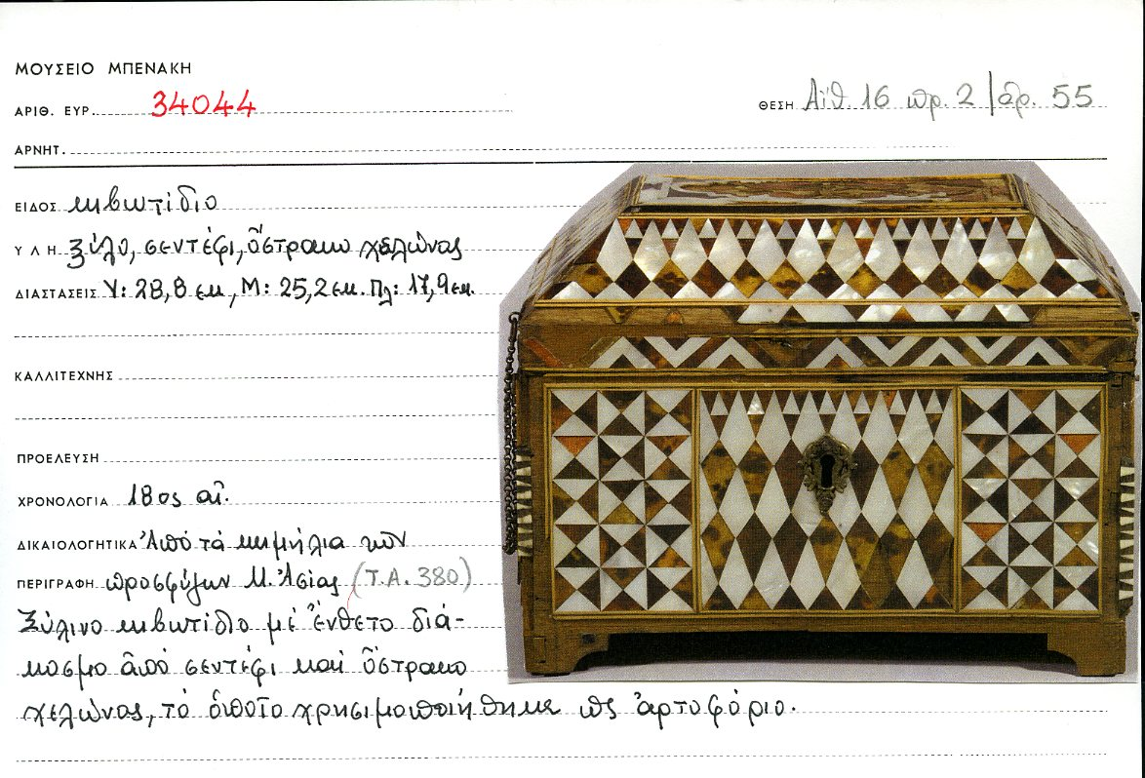
Benaki museum object catalogue card
Courtesy Ifigeneia Dionyssiadou, Benaki Museum

Slide 5
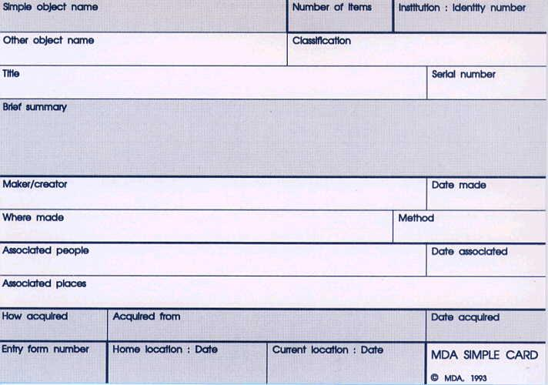
MDA object card – front side

Slide 6
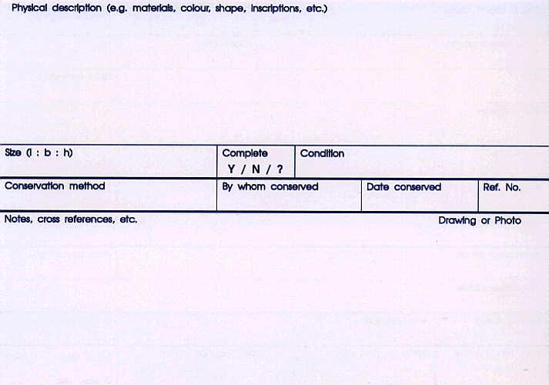
MDA object card – back side

Slide 7
Standards for museum cataloguing
Information structure standards
  How should information be organised in fields / data structures?
  CDWA, VRA core, CIDOC categories…
  MIDAS Heritage
  CIDOC CRM, CRM Core
Information content standards
  Which values should be used for each field, and how?
  Authorities: thesauri, controlled vocabularies
    E.g., Art and Architecture Thesaurus, TGN, ULAN, LC Thesaurus for Graphic Materials…
  Syntax conventions and other object description guidelines
Procedural standards
  What steps should be followed to ensure proper collections management?
  E.g., SPECTRUM by Collections Care (UK, ex-MDA), CCO

Slide 8
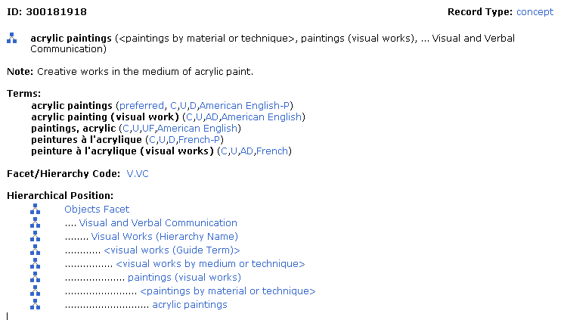
AAT term: acrylic painting

Slide 9
General structure of an object documentation record
P.Constantopoulos et al., Cultural documentation and interoperability guide, 2005, http://www.ics.forth.gr/CULTUREstandards
Record identification
    Metadata concerning the record as a digital object in itself.
Object identification
    The minimum data necessary to identify the object independently from any particular context.
Scientific documentation
  Description of the object as is
    Classifications, physical constituency and condition, symbolic content, etc.
  History of the object as reported by witnesses or inferred from traces and evidence
    Descriptions of events and activities, such as construction, use, discovery, conservation, etc., in which the object took part.
  Associations of the object with other objects (e.g., similarity) and events.
Administration
    Data pertaining to the current handling of the object in a museum or collection, e.g. acquisition, location, exhibition, loan, etc. These may subsequently become part of the object history.
References
    Metadata about sources of documentation and related bibliography.

Slide 10
Nature of documentation data - 1
They describe
Entities
  Physical: the object being documented and, possibly, others related to it.
  Conceptual: they appear in the context of their relation to the object being documented.
Events
  Determined by:
    kind
    limits in place and time
    persons, organizations and objects involved in specific roles
    constituency from other sub-events.
  Activities: an important class of events further characterized by:
    actor, purpose and technique.
  Events are only recorded in the context of their relationship to the object being documented.
Associations
  Represent comparisons between objects (e.g. similarity) or cultural context (e.g. joint use of objects, depiction or copy making, witness).

Slide 11
Nature of documentation data - 2
Temporal validity
permanent : unlimited validity
volatile : limited over a specific time interval
  data should normally be tagged with their validity time

Slide 12
Nature of documentation data - 3
Information in a record as a set of logical propositions
May refer to
  specific situations or occurrences
    the pen with which Eleftherios Venizelos signed the Protocol of the Sevres Convention
    the necklace worn by Queen Amalia on her wedding
  categories
    wedding dress, flag carried in the battlefield, clay pot
May convey
  part of the history of a particular object
  a hypothesis about part of the history of an object, with reference to categories of events and entities
  knowledge about kinds of objects and events, not about a particular object

Slide 13
Information patterns : examples
Date from until | Object composition number of parts part name kind code or cardinal number
Chronology within throughout cultural period social time justification | Place name code cadastral number kind geopolitical hierarchy address coordinates values reference point precision of measurement geodesic coordinate system link to design
Dating chronology time measurement value method laboratory | Event name kind chronology place description persons involved organizations involved objects involved comprises events
Person name biographical data communication data role / capacity / social group | Organization title legal address communication data department role / capacity / social group

Slide 14
Data entry
Follows object handling workflow, but some autonomy of the data entry process is desirable
Data entry rule
  necessary value omission disallowed
  compulsory value must be entered if it exists and is known
  optional
  Favours breadth over depth
Value uncertainty
  Conventional policy: least binding
    Date ‘unknown’ or ‘before 1900 AD’
  Effective policy: most precise values within the limits of the documenter’s knowledge
    A personal computer of unknown production date could be safely dated ‘after 1980 AD’
Value multiplicity : multiple values by default, unique if specified so

Slide 15
Object record types
In practice desirable to have a controlled variety of records thus supporting uniform documentation practices.
Criteria for record type definition:
Intended use | Object type
registration description administration conservation digital preservation publication of digital material | site monuments moveable objects text documents audio pictures (still, moving) digital surrogates inherently digital objects

Slide 16
Patterns of information usage
Objects of inquiry conceived as ‘whole’, structured entities
  Need information concerning very different aspects of such objects
Individual object is often the starting point for information retrieval
  Research on individual resource, document, object is common
Associative access of information
  Scholars typically need to assemble contextual information about an object:
    creator
    history and topography of provenance
    interpretation of themes represented
    other related artworks or artifacts

Slide 17
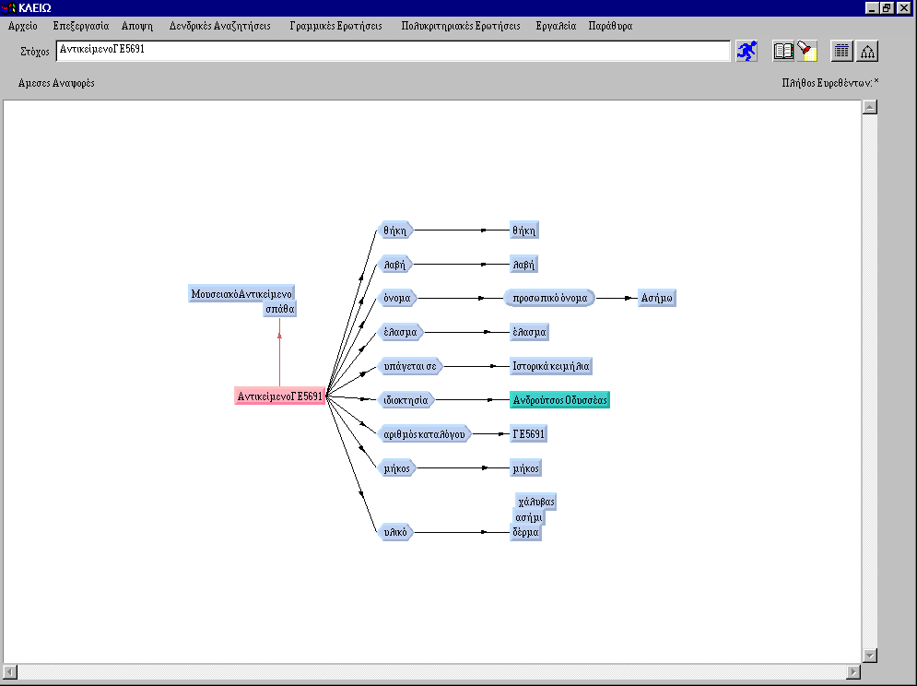
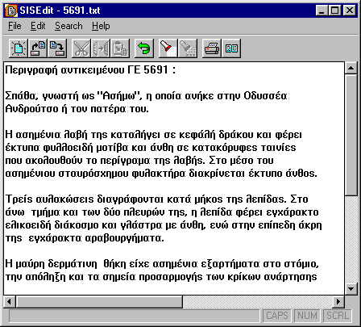
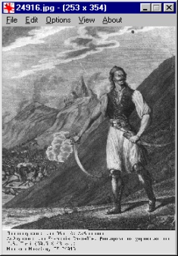
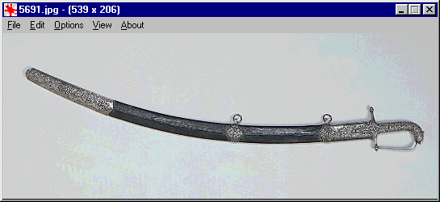
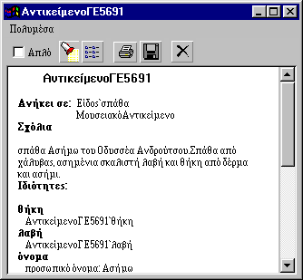
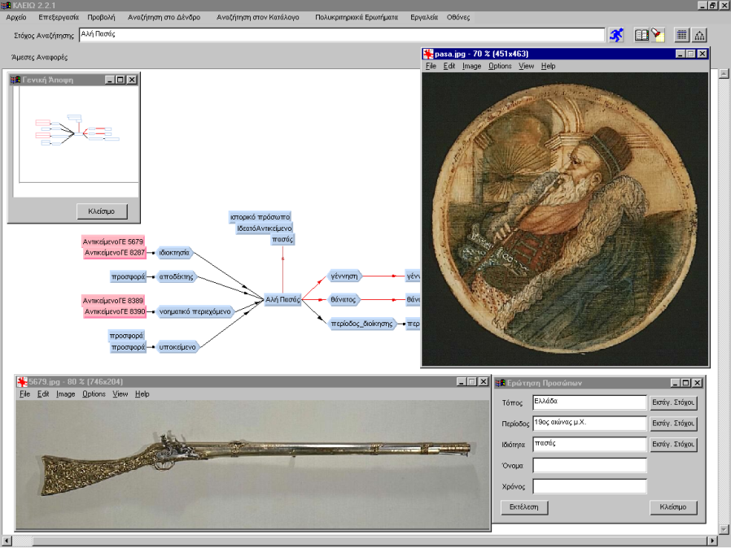
CLIO thematic cultural documentation system
Main characteristics
Semantic network knowledge base
Domain ontology, precursor to CIDOC/ICOM CRM
Particularly dense information linking – rendering of historical and cultural context
Recording of uncertain, incomplete or inconsistent statements
Unlimited access through chained references
Applications
Benaki Museum, Documentation department
Ancient Theatre Programme, Institute of Mediterranean Studies – FORTH
Centre for Cultural Informatics, ICS-FORTH
Benaki Museum
P. Constantopoulos, "Cultural Documentation: The CLIO System", Technical Report FORTH-ICS-TR115-1994, Institute of Computer Science, Foundation of Research and Technology - Hellas, January 1994.

Slide 18
The basic CLIO premise
The ultimate goal of users is not just to get information about an object but to understand a topic.
Understanding is based on associations.
CLIO: 1993-1996
The basic premise and the information model of CLIO will become the origin of the CIDOC CRM development (1996-2006)

Slide 19
The hardships of integrated access
"Do you have any film of the last V-1 to fall on London?"
  Requires a knowledge of both the nature of a "V1" and a complex temporal inference.
"Do you have any miniatures depicting the 'churning of the milky ocean'?"
  Requires a detailed knowledge of Indian Iconography to know where, in what object genres and which contexts this might be shown.
        After D. Bearman & J. Trant,
        http://www.archimuse.com/papers/ukoln98paper/index.html

Slide 20
Find documents related to the Yalta agreement After M. Doerr
Historical archives….
Type: Text
Title: Protocol of Proceedings of Crimea Conference
Title.Subtitle: II. Declaration of Liberated Europe
Date: February 11, 1945.
Creator: The Premier of the Union of Soviet Socialist Republics
The Prime Minister of the United Kingdom
The President of the United States of America
Publisher: State Department
Subject: Postwar division of Europe and Japan
Documents
Metadata
“The following declaration has been approved:
The Premier of the Union of Soviet Socialist Republics,
the Prime Minister of the United Kingdom and the President
of the United States of America have consulted with each
other in the common interests of the people of their countries
and those of liberated Europe. They jointly declare their mutual
agreement to concert…
….and to ensure that Germany will never again be able to
disturb the peace of the world…”
About…

Slide 21
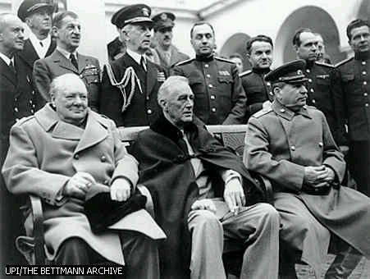
Yalta, cont’d
Photo archives…
Type: Image
Title: Allied Leaders at Yalta
Date: 1945
Publisher: United Press International (UPI)
Source: The Bettmann Archive
Copyright: Corbis
References: Churchill, Roosevelt, Stalin
Photos
Metadata
About…

Slide 22
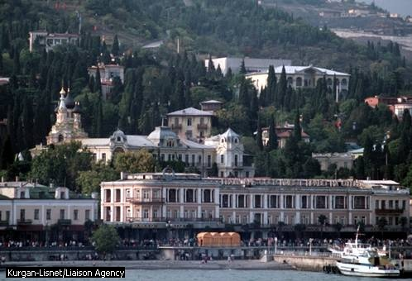
Yalta cont’d
Gazetteers…
TGN Id: 7012124
Names: Yalta (C,V), Jalta (C,V)
Types: inhabited place(C), city (C)
Position: Lat: 44 30 N,Long: 034 10 E
Hierarchy: Europe (continent) <– Ukrayina (nation) <– Krym (autonomous republic)
Note: …Site of conference between Allied powers in WW II in 1945; ….
Source: TGN, Thesaurus of Geographic Names
Places, Objects
About…
Title: Yalta, Crimean Peninsula
Publisher: Kurgan-Lisnet
Source: Liaison Agency

Slide 23
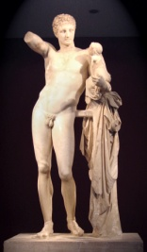

Semantic interoperability
Unified access to autonomous digital collections
Value multiplier
Ontology
General:
general concepts and relations,
language-neutral
Domain:
specialized extensions, multilingual
Semantic resource descriptions
<tag1>
<tag2>
<tag3>
</tag1>
Digital resources
Notes:
23

Slide 24
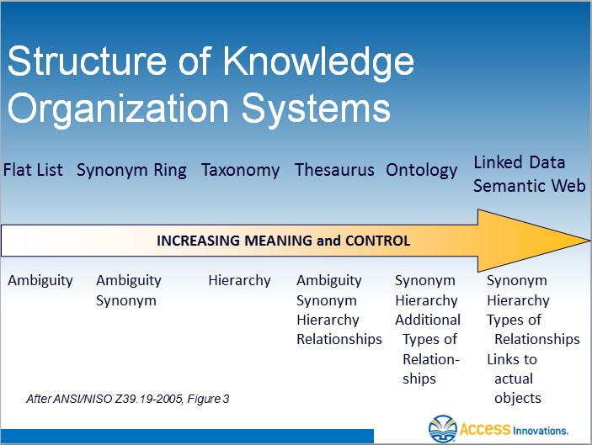

Slide 25
Defining semantics
What is a plug (electric)?
Common understanding among the persons involved in a conversation
Implicit
Less ambiguity
Better interoperation
Greater difficulty
Explicit,
informal
Plug: “a device for connecting an appliance to a power outlet”
Formal,
for humans
Designs and technical data
Formal,
for machines
Formal logical language

Slide 26
Thesauri : Utility of Vocabulary Control adapted from: M. Doerr: Thesauri and Ontologies
Users and maintainers of information systems do not talk to each other.
Computers understand only letters, symbols, but not
  grammatical forms (destruction - destroyed)
  Morphological variants (harbour - harbor)
  synonyms (port - harbour)
  multiple aspects (edged weapons - cutting instruments)
Hence - controlled vocabulary for identity of expression.
  How to define the vocabulary? Just a list of words ?
  But it is never complete...
  What to do with free texts, legacy data ?

Slide 27
What is a Thesaurus ibid
Definition (ISO2788)
  The vocabulary of a controlled indexing language, formally organised so that a priori relationships between concepts are made explicit
Concept based:
  All semantic relationships between concepts, words or terms only as“finding aids” or arbitrary identifiers of concepts. One node per concept.
Language based:
  Relationships between terms, as finding aids, about general conceptual closeness and translation. Definition of linguistic properties, sometimes presentation instructions for dictionary creation. One node per term.

Slide 28
Concepts ibid
A concept is a class or set of entities which are grouped together on the basis of some criterion or rule
  Internal representation- the personal comprehension
    cannot be communicated
  A set of entities characterised by explicit properties (rules)
    “objective”, enables analogical reasoning
    how to characterise properties?
    find discriminative attributes (what is an Elephant?)
    non-verbal characteristics (aquarelle etc. )
    often difficult, misleading, impossible

Slide 29
Concepts ibid
  The “words of mentalese”, the language of the mind
  A set of entities characterized by common agreement
    e.g. we agree, that this: is “orange (colour)”
    depends on a social group (must be noted!!)
    covers everything people can recognize and agree on (implicit mentalese)
    does not allow analogical reasoning

Slide 30
Concepts ibid
Concepts are relative
  in scope : fuzzy bounds , e.g. knife, weapon, seat,
    outer bounds for retrieval, inner for science, if negated inner bounds for retrieval….
  to purpose : weapon, friend, stone building, school house, neoclassic building
    existential classes (reason for existence)
    construction-related, morphological, functional, contextual
Concepts are related
  in nature : coffin - container, coffin - funerary object, bath tube - container
    multiple hierarchies of genus-species OR isA OR generalization OR subclass-superclass (also similarity)
    associative : bridge - bridge construction, house - roof

Slide 31
Concepts ibid
For retrieval, we must find well defined concepts
  uniquely identifiable without dialogue
  with wide agreement
  for precise, reproducible classification and retrieval
Concepts can be
  natural and explicit - there is a term for it in some language
  natural implicit (hidden) - there is no word
    English “parts & accessories”
    need to be invented
  new - like “the Web”
  constructed - “blue rugs”, “19th century Persian rugs”, open problem
Natural concepts are the best, but often others are needed
  typically redefined (AAT “knife”) or combined.

Slide 32
Concepts ibid
Concepts should not be changed
  they should be created or abandoned
  they should be understood, accepted or rejected

Slide 33
Concepts and Words ibid
Words are not used to define concepts.
  Words lead to concepts (so-called “SYN”, “UsedFor” relations)
  Words and terms follow a grammatical normalisation
  A term can be selected as unique concept identifier by convention:
  so-called DESCRIPTORS, e.g. “pink (color)”
  the concept is defined separately
  Term combination rules for obvious combination without further meaning
    museums & object type, country & rugs, object type & period….

Slide 34
Concept Definition ibid
By “Scope Note” :
  A statement that clarifies the meaning and usage of a term within the thesaurus
    Definition by properties, occurrence, similarities
    Definition of scope - bounds and distinctions
    Context of usage, purpose, view
    Origin and history of the term and concept
    Guidance of users to similar, overlapping, associated concepts
Reference to literature (“literature warrant”)

Slide 35
Concept Definition ibid
By Example
  Name (e.g. Mona Lisa), image, video, sound-track
Visually
  drawings, images of models
By semantic relations
  Generalization / specialization:
    hierarchies with inclusion properties
  Associations to other concepts:
    co-occurrence in certain contexts, producer-process-product relations etc.
  Synonyms, similar concepts, translations

Slide 36
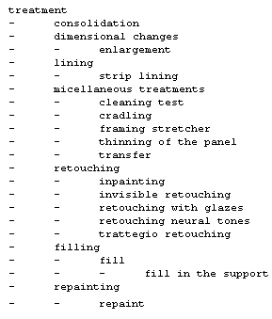
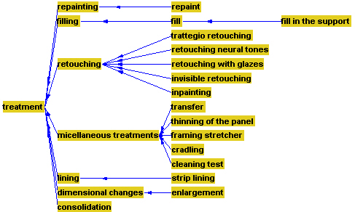
Hierarchies ibid
The Hierarchy “treatment”: Graphical View and Hierarchical Display

Slide 37
Semantic networks
name
Person
String
lives in
isa
creates
Artist
Artifact
isa
isa
isa
isa
Painter
Sculptor
Painting
Sculpture
isa
paints
sculpts
“a Person has a name and lives_in somewhere . Artists are persons, painters
and sculptors are artists. An artist creates artifacts. Paintings and sculptures are artifacts. A painter paints paintings and a sculptor sculpts sculptures.”

Slide 38
The CIDOC Conceptual Reference Model - CIDOC CRM
ISO 21127
An ontology describing the underlying semantics of data schemata and structures of all museum disciplines and archives.
Harmonized with IFLA FRBR concepts
  The basic MLA (museum-library-archive) ontology
Does not dictate the documentation elements
The outcome of long-term interdisciplinary work and agreement.
Essentially, a generic model for recording “what has happened”.
It can generate event-centric networks of knowledge
  Supports effective metadata structures and linking schemes
Notes:
38

Slide 39
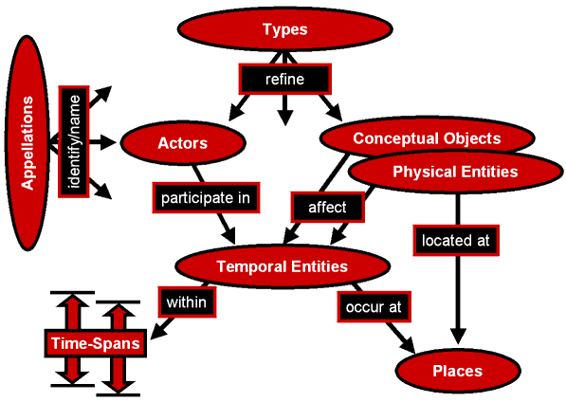
CIDOC CRM: general structure
Notes:
39

Slide 40
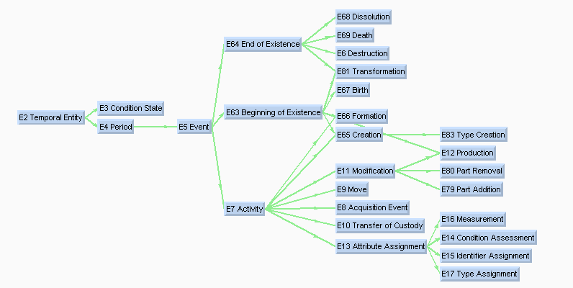
The temporal entity hierarchy

Slide 41
Classes of temporal entities
E2 Temporal Entity
  Properties: P4 has time-span (is time-span of): E52 Time-Span
E4 Period
  Properties: P7 took place at (witnessed): E53 Place
    P9 consists of (forms part of): E4 Period
    P10 falls within (contains): E4 Period
E5 Event
  Properties:
  P12 occurred in the presence of (was present at): E77 Persistent Item P11 had participant (participated in): E39 Actor
E7 Activity
  Properties: P14 carried out by (performed): E39 Actor
    P20 had specific purpose (was purpose of): E7 Activity
    P21 had general purpose (was purpose of): E55 Type

Slide 42
General types of relations in CIDOC CRM
Identification of real world items by real world names.
Classification of real world items.
Part decomposition and structural properties of Conceptual and Physical Objects, Periods, Actors, Places and Times.
Participation of persistent items in temporal entities.
  creates a notion of history: “world-lines” meeting in space-time
Location of periods in space-time and physical objects in space.
Influence of objects on activities and products and vice-versa.
Reference of information objects to any real-world item.

Slide 43
Creating a knowledge network over a digital library of historical documents
“Turkish Archive of Chania” project
A system for classification, documentation and microphotography of the Turkish Archive of Chania
“ARCHON” project
A multimedia system for archival, annotation and retrieval of the historical archives of the Vikelaia Municipal Library of Heraklion
  Turkish Archive of Heraklion
  Municipal Archive of Heraklion
  Venetian Archive
Centre for Cultural Informatics, ICS-FORTH

Slide 44
Digitized document: an example
Turkish Archive of Heraklion
Α’ Sacred Judicatory Statute Books
Statute Book 3, pages 106-107
Translations of Turkish Historical Documents
N. Stavrinidis
Volume Α’, Translation 499
Notes:
44

Slide 45
Document description
Publisher: Ιεροδικείο
Place of publishing : Χάνδακας
Date of publishing: 29 Recep 1082
1 Δεκ. 1671
has translation: Μετάφραση 499
kept in: ΚΑ 1.1 ΑΑ 3-106
refers to activity: Ανανέωση γάμου
refers to object: Δωρεά
  γαμήλια
  μη προκαταβαλλόμενη
  2000 άσπρα
  took place at: Χάνδακας
  invokes: Ιμπραχίμ Μπεσέ
  Μουσταφά Μπέης
Notes:
45

Slide 46
Archival catalogue entries
Archival Unit
kept in
Item
Translation
has translation
has transcription
Transcription
has place of publishing
Document
Place
has date of publishing
Date
Entry
has publisher
has recipient
Actor
Actor
has date of entry
quotes
Date
Description
has type
Document Type
Notes:
46

Slide 47
Multi-faceted thematic description
Activity Type
Description
has type
Activity
refers to activity
took place at
Place
Activity
took place during
Actor
Time
Object
invokes
Actor
Time
refers to object
Place
Object
Notes:
47

Slide 48
Reasoning over an ontology-based knowledge network
Actors
(persons and organizations)
Activities
Objects
Faceted schema
invokes
refers to
Pasha
Purchase
Fire
House
Fact data base
Veli’s House
Omer Pasha
Fire 1658
Purchase Act 43
Document Digital Library
Notes:
48

Slide 49
FRBR – CRM harmonization
A manifestation of “M-L-A convergence”
E11
Modification
E65
Creation
E12
Production
E55
Type
E28
Conceptual
Object
F31 Expression
Creation
F3 Manifestation
Production Type
F40 Carrier
Production
Event
R9 comprises
carriers of
R41 produced
(was produced by)
R49 created a
realization of
R22
created
E24
Physical
Man-Made
Thing
F1 Work
F2 Expression
E84
Information
Carrier
R45 created
R10 belongs
to type
R56 is realized in
F21 Complex
Work
F46 Individual
Work
F20 Self Contained
Expression
F23 Expression
Fragment
F4 Manifestation
Singleton
F5 Item

Slide 50
Digital resources
Kinds of digital resources:
Data, primary and secondary
Models
  Guides for interpreting and associating data
Terminology
For all digital resources one should ensure:
Quality
Preservation
Usability
digital curation

Slide 51
Digital curation
A set of activities aimed at:
  producing good quality, trusted digital assets;
  organization and archiving;
  preserving the assets, as well as their conceptual foundation and context;
  enabling the generation of new knowledge from those assets; and
  enabling access and use
Interdisciplinary
Prohibitively difficult and expensive for single institutions to cope with

Slide 52
Digital curation process model (DCU)
digital curation
context management
digital resources lifecycle management
goal and usage models
appraisal
usage experiences
domain
models
classification
indexing
cataloguing
knowledge enhancement
presentation
publication
dissemination
ingestion
authority management
repository management
preservation

Slide 53
Major challenges
Support multiple interpretation and context
  Interpretive communities: by language, cultural identity, scientific tradition, …
  Alternative interpretations: authoritative interpretation challenged
Evolving semantics:
  Research induces re-interpretation
  Collections are conceptually re-organized and symbolic representations renewed
Support scholarly discourse and knowledge process

Slide 54
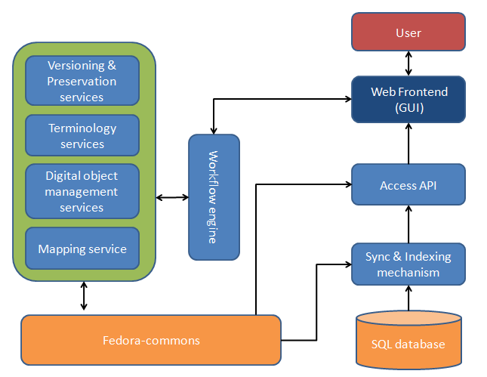
MOPSEUS repository system
DCU – IMIS, R.C. Athena
Ease of installation
Ease of configuration
Supports custom metadata schemas
Preservation workflows
Web-based
Interoperable
Pre-configured versions
FedoraCommons - based

Slide 55
Aggregating cultural content in the CARARE project
Content providers
CARARE
OAI–PMH provider
Common
format
Harvester
Mapping
Ingest
Export
Mapping service
Common
format
Europeana
Original metadata
CARARE repository
Versioning service
Enrichment
Service
(SKOS, Geo-info)
Previewing
service
Revision
service
Curation services
Dataflow services

Slide 56
MoRe (Monument Repository) aggregator
The engine powering the CARARE repository and more
An extended aggregator service that incorporates services operating on the metadata (repository services):
  Multi-step process
  Long lifecycle of metadata
  Supports metadata preservation
  Enables added-value from all the aggregated content

Slide 57
MoRe information flow
Negotiation for acceptance
Checks
Content Providers
Mapping tool
Structural
Native XML
SIP
Well-formedness
Integrity
Define Mapping
AIP
Versioning
Native, CARARE, Mapping,
Provider & item admin info
(package independence)
EDM
(selected data)
Repository
DIP
RDF
Europeana
Enrich
CARARE
EDM
Mapping
AIP
AIP
OAIScompliant model

Slide 58
Preservation awareness
All ingest / curation actions generate a PREMIS event which accompanies each record.
Multiple curation actions generate multiple PREMIS records that are stacked together thus forming a complete log.
All Curation actions generate new versions of the affected datastreams while preserving the old ones
SIP
Admin Metadata
Native Metadata
CARARE Metadata
XSLT Trans. Doc
EDM Metadata
PREMIS

Slide 59
Curation micro-services
Element and attribute cleaning
Element and attribute fill
Spatial transformation
Relation addition
De-duplication

Slide 60
Element & attribute clean/filling
<carare id=“001”>
<heritageAssetInformation>
<appellation>
<id>001</id>
<name lang=“gre”>Ακρόπολη</name>
<name lang=“gre” preferred=“true”>Παρθενώνας</name>
</appellation>
</heritageAssetInformation>
<digitalResource>
<link>http://acropolis.gr/001.tiff</link>
<format>tiff</format>
<spatial>
<address>
<locality>Acropolis</locality>
<townOrCity>Athens</townOrCity>
<country>Greece</country>
</address>
</spatial>
</digitalResource>
</carare>
<edm:ProvidedCHO>
<dc:title xml:lang=“el”>Παρθενώνας</dc:title>
<dcterms:alternative xml:lang=“el”>Ακρόπολη</dcterms:alternative>
</edm:ProvidedCHO>
<edm:Type>IMAGE</edm:Type>
<edm:Place>
<skos:prefLabel>Acropolis, Athens, Greece</skos:prefLabel>
</edm:Place>

Slide 61
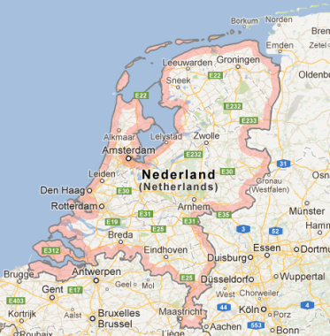
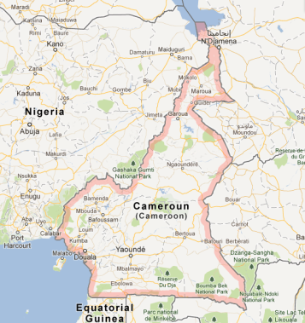
Spatial transformation
<carare id=“001”>
<digitalResource>
<spatial>
<spatialReferenceSystem>
EPSG:28992
</spatialReferenceSystem>
<cartographicReference>
<spatialFeatureType>
point
</spatialFeatureType>
<car:coordinates>
<x>121821; 487476</x>
<y />
</car:coordinates>
</car:cartographicReference>
</spatial>
</digitalResource>
</carare>
<car:coordinates>
<x>121821</x>
<y>487476</y>
</car:coordinates>
Check coordinate system:
spatialReferenceSystem : EPSG:28992
Transform → WGS84 :
<wgs84_pos:lat>52.37415441823642</wgs84_pos:lat>
<wgs84_pos:long>4.899978444680552</wgs84_pos:long>
Check if X/Y → Lat/Lon
or
Lon/Lat
Check if the monument is located in the country that is described in the record (country code = NL)

Slide 62
Registry services
Act as a glue for building data infrastructures
Employ existing repositories and services
Enable the creation of added value services

Slide 63
Diversity and complexity
Multiple schemas:
  CARARE 1.0
  CARARE 2.0
  EDM
  ACDM
  DCCAP
  Extended Dublin Core
  LIDO
  EAD
  ESE
  SKOS
Diverse ingestion methods:
  OAI-PMH
  REST Services
  Web UI

Slide 64
Ontology-driven information seeking

Slide 65
INDIGO robotic guide
INDIGO robotic guide

Slide 66
Looking for query patterns
Approach A: Analyze sets of user queries
Approach B: Reverse engineer query patterns from sets of affirmative statements
  Source material: 5 collection catalogs with descriptive texts
    approx. 1250 descriptions studied
  Statements considered as answers to tacit questions
  Reveal important information from expert’s point of view
Notes:
28/09/2009
ECDL'09

Slide 67

From statements to tacit Questions
Each statement considered as answer to one or more questions
Q1: What is this object?
  This object is a lekythos (Attic funerary vessel)
Q2: What is the identification number of this object?
  No 1055
Q3: Where was it found?
  At the tomb of Dipylos
Q4: Which is the figure of the depiction it carries?
  Theophanti
Notes:
28/09/2009
ECDL'09

Slide 68
Summary of empirical study
82 distinct questions recorded
Most of them recur throughout the descriptions
  Universal queries: who, where, when, what (as expected)
  Frequency of remaining: at least 25%
Semantic representation: each question (and answer) represented as RDF graph
Notes:
28/09/2009
ECDL'09

Slide 69
Creating the RDF graphs
For each statement, create its graph, e.g.
  “This lekythos was found at the tomb of Dipylos and carries
  a depiction showing Theophanti.”
Lekythos
carries
Depiction
depicts
Figure
found at
Place
this_lekythos
carries
this_depiction
depicts
Theophanti
found at
Tomb of Dipylos
Notes:
28/09/2009
ECDL'09

Slide 70
Signatures
Consider schema graph
Retain structure, omit semantics
Lekythos
carries
Depiction
depicts
Figure
found at
Place
A
P
B
Q
C
R
D
Signature
Notes:
28/09/2009
ECDL'09

Slide 71
8 signatures identified
A
P
B
A
P
B
A
A
P
B
Q
Q
R
C
C
A
P
B
Q
C
A
P
B
Q
A
P
B
Q
C
A
P
B
Q
C
R
R
D
D
Notes:
28/09/2009
ECDL'09

Slide 72
Query pattern: an example
Query:
  Find all objects that depict the same figure as the current object, but which have been found at different places
Reformulate the previous query:
  Find all objects a' that carry a depiction b' which depicts the same figure c as the depiction b carried by the current object a, but which have been found at place d' different than place d where a was found
Notes:
28/09/2009
ECDL'09

Slide 73
Find all objects a' that carry a depiction b' which depicts the same figure c as the depiction b carried by the current object a, but which have been found at place d' different than place d where a was found
a
p
b
q
c
q'
b'
p'
a'
r
d
d'
r'
Notes:
28/09/2009
ECDL'09

Slide 74
Graph pattern:
  A: Object, B: Depiction, C: Figure, D: Place
A
P
B
Q
C
R
D
a
p
b
q
c
q’
b’
p
a’
r
d
d’
r’
Notes:
28/09/2009
ECDL'09

Slide 75
Graph pattern + Variables characterization
  Known: A, P, B, Q, C, R, D, a, p, b, q, c, r, d
  Unknown: a', p', b', q', r', d'
  Searching: a'
A
P
B
Q
C
R
D
a
p
b
q
c
q'
b'
p'
a'
r
d
d'
r'
Notes:
28/09/2009
ECDL'09

Slide 76
Testing against robotic tours
The adequacy of query patterns was tested on the basis of coverage of user questions addressed to the INDIGO robotic guide
Log of user queries (dialogues) posed to a robot acting as an online guide
  23 distinct tours examined
  Each tour containing from 10 to 50 questions posed by a user
93% of the questions covered by the 23 query patterns developed
  Remaining questions refer to categorical knowledge
Notes:
28/09/2009
ECDL'09

Slide 77



The development of the DYAS infrastructure is funded by the National Strategic Development Framework (ΕΣΠΑ) 2007-2013 through the projects DARIAH-ATTIKH and DARIAH-ΕΠΑΕ.
Partners
Academy of Athens, co-ordinator
Athena Research Centre
National and Kapodistrian University of Athens
Athens School of Fine Arts
Institute for Communication and Computer Systems, National Technical University of Athens
Foundation for Research and Technology - Hellas

